Slide 1
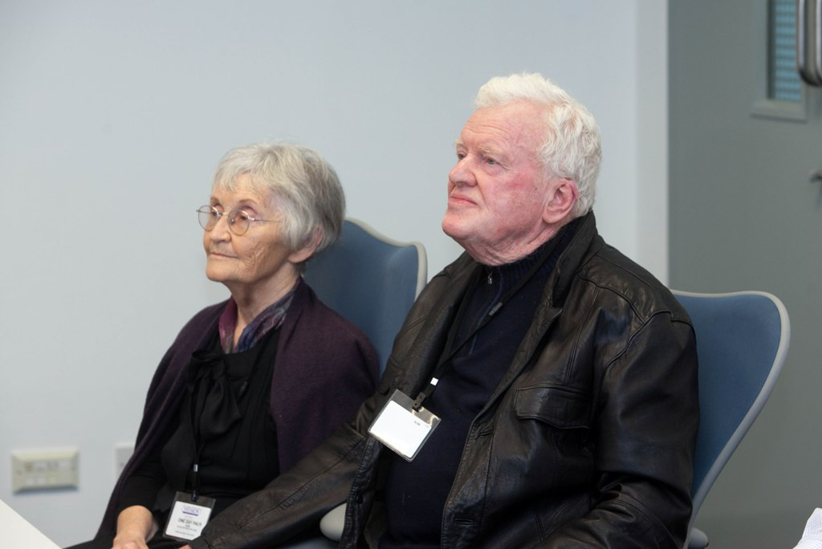
Brian Mooney and Noreen Mooney, parents of Brecan Mooney. The Geothermal Installation of the Year award is named in memory of Brecan Mooney, who was active in the research and promotion of Geothermal Energy in Ireland up to his loss in November 2009. This award aims to continue Brecan’s work by showcasing excellence in geothermal systems design and installation in Ireland.

Slide 2
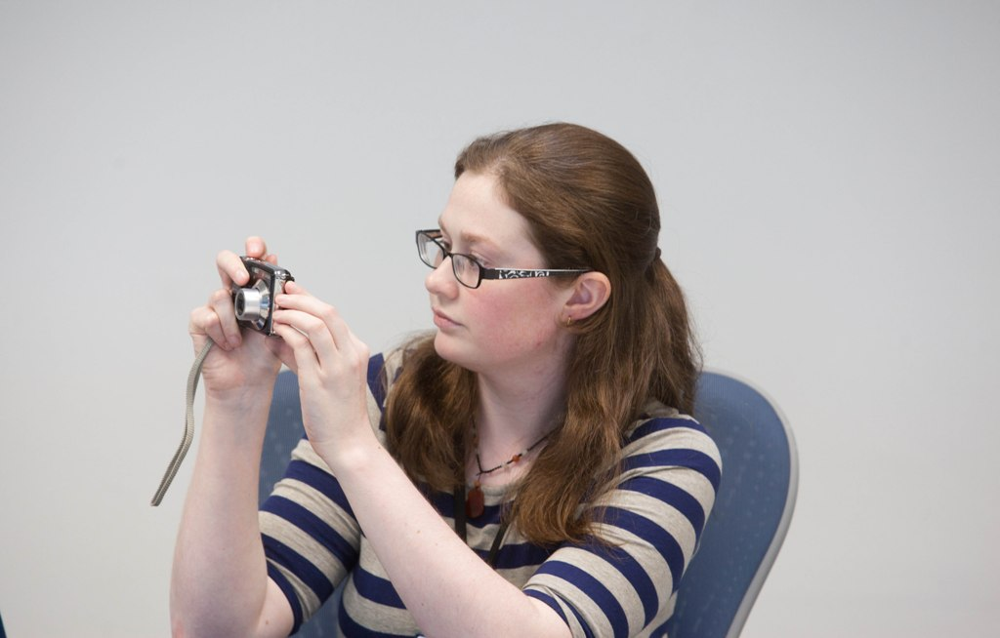
Laurena Lacey (GAI Member)

Slide 3
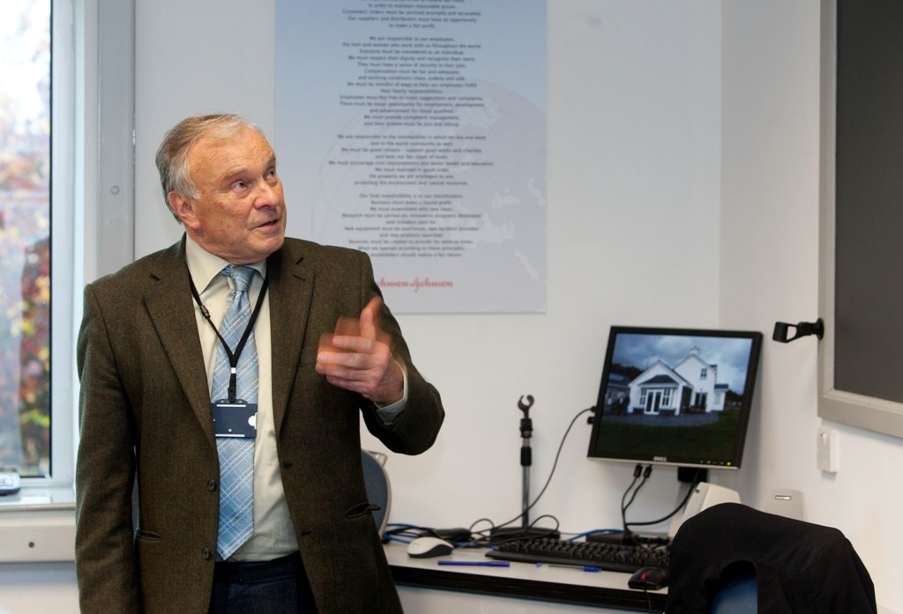
Paul Sikora, GAI Development Officer

Slide 4
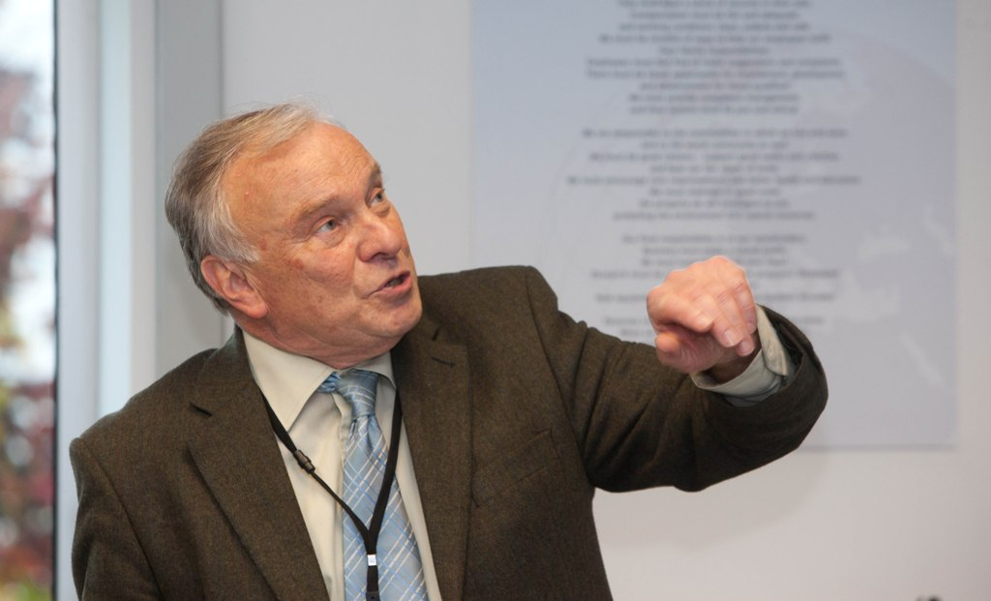
Paul Sikora, GAI Development Officer

Slide 5
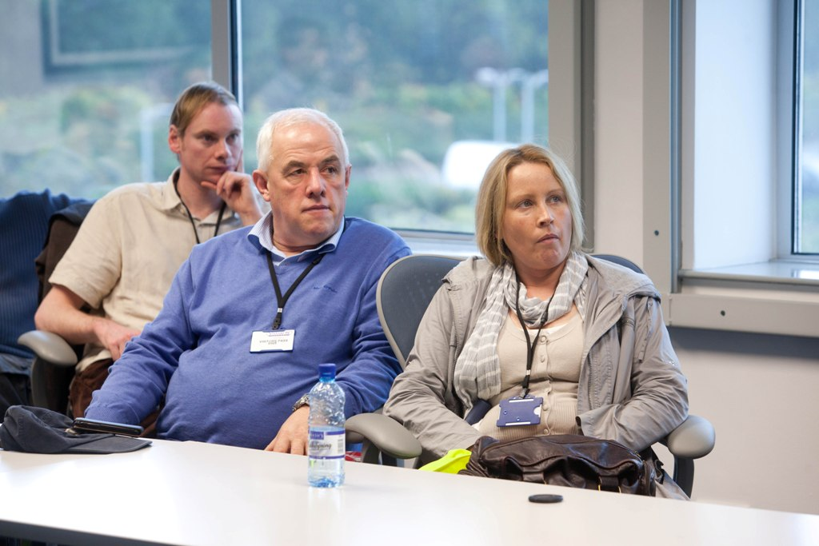
Attendees at the Award Ceremony of the Brecan Mooney Installation of the Year Competition

Slide 6
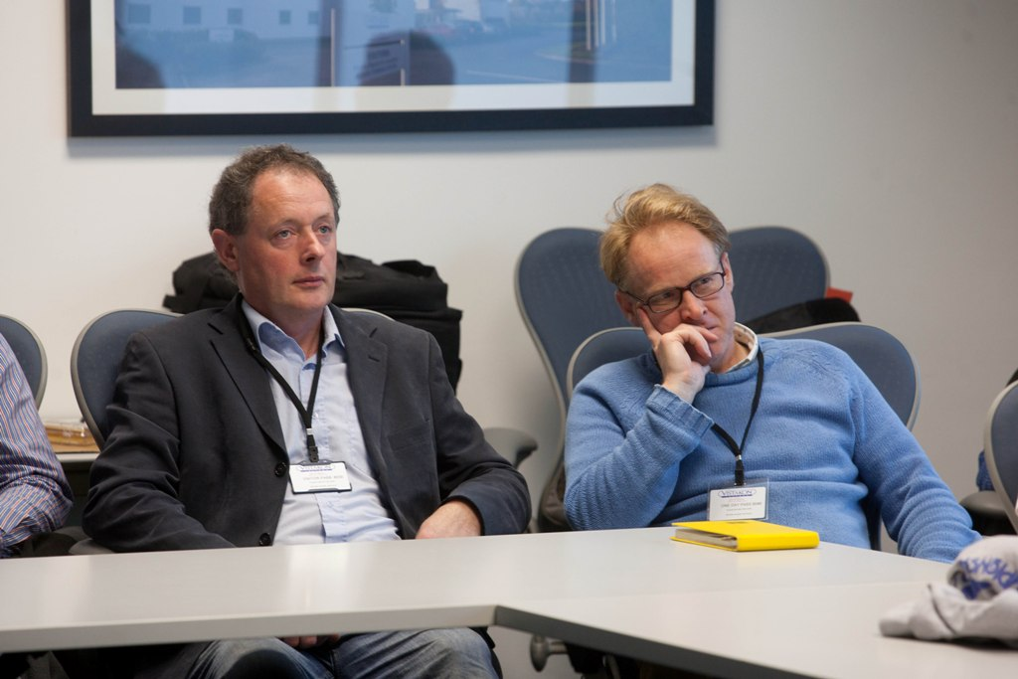
Attendees at the Award Ceremony of the Brecan Mooney Installation of the Year Competition

Slide 7
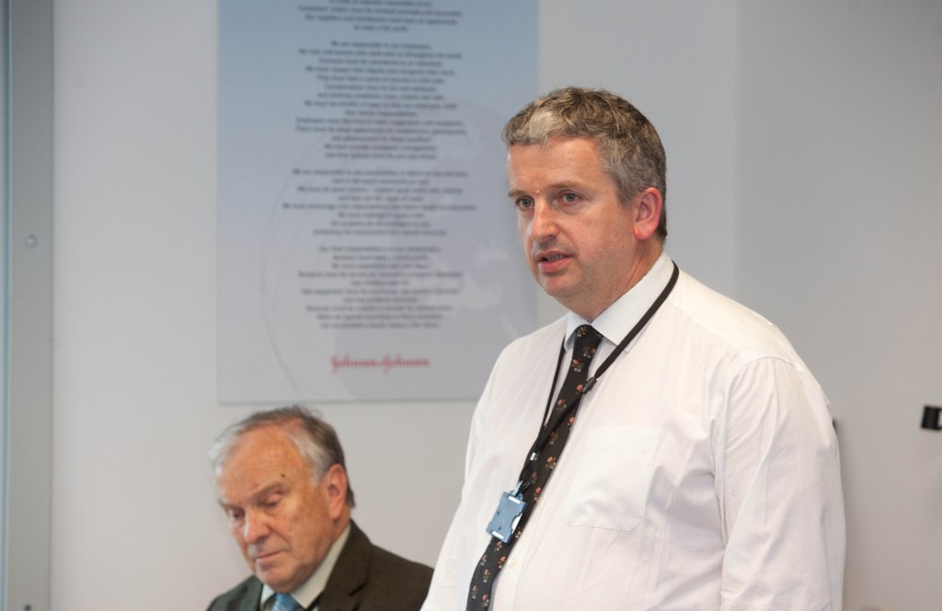
Paul Sikora, GAI Development Officer (seated), John Burgess, Chairman of the GAI (standing)

Slide 8
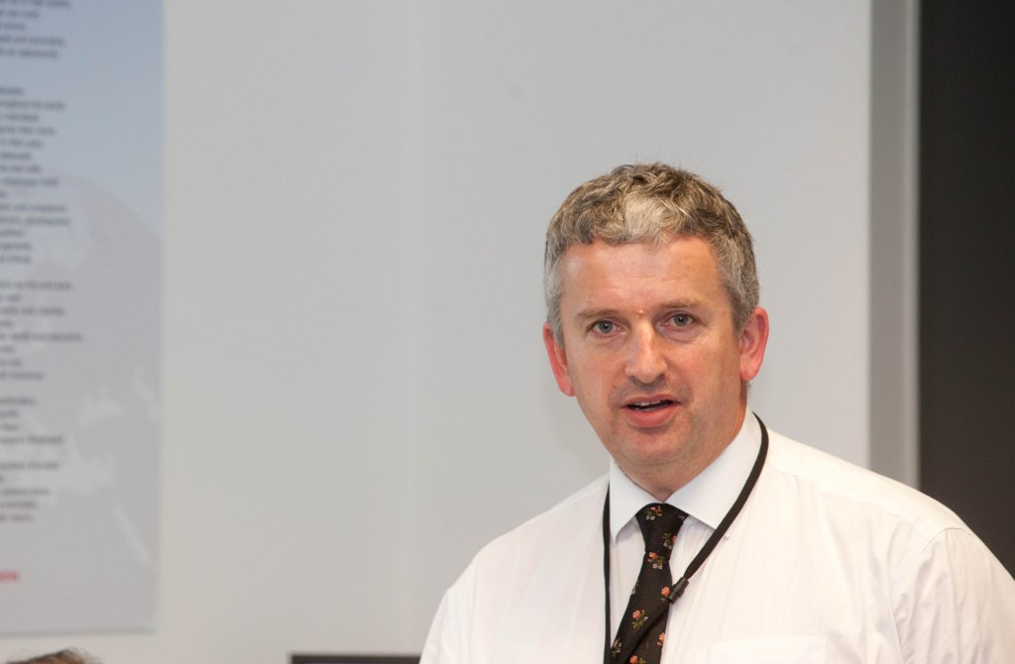
John Burgess, Chairman of the GAI

Slide 9
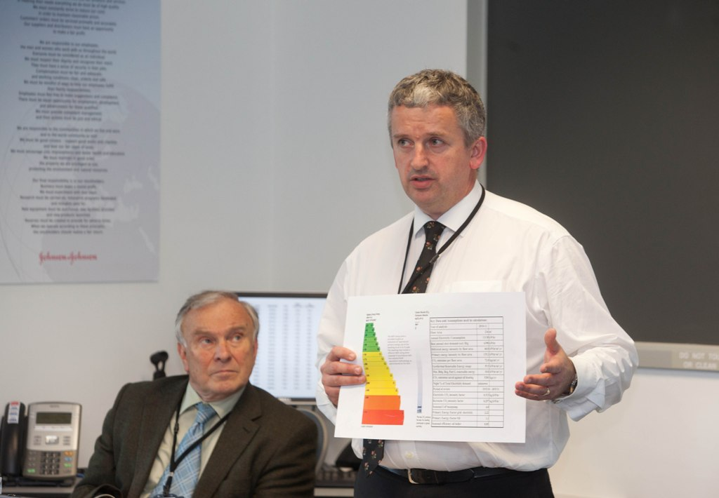
Paul Sikora, GAI Development Officer (seated), John Burgess, Chairman of the GAI (standing)

Slide 10
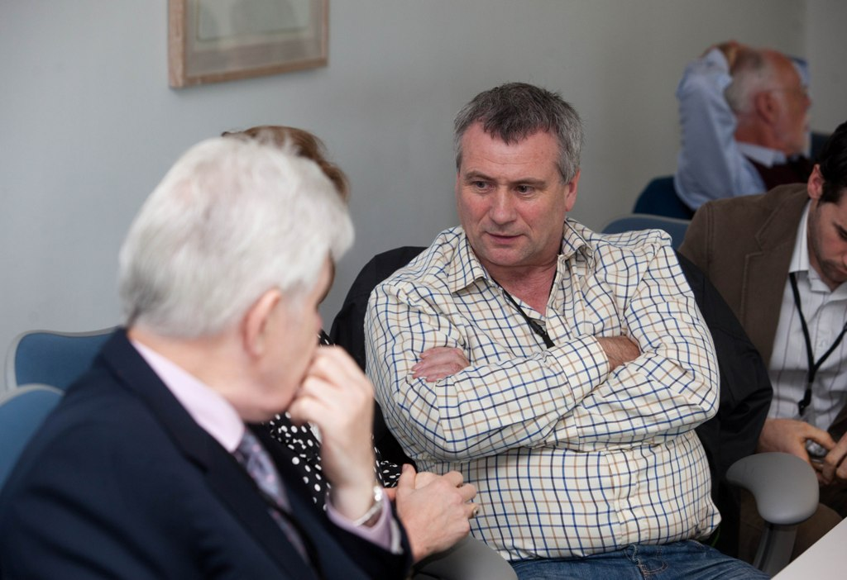
Attendees at the Award Ceremony of the Brecan Mooney Installation of the Year Competition

Slide 11
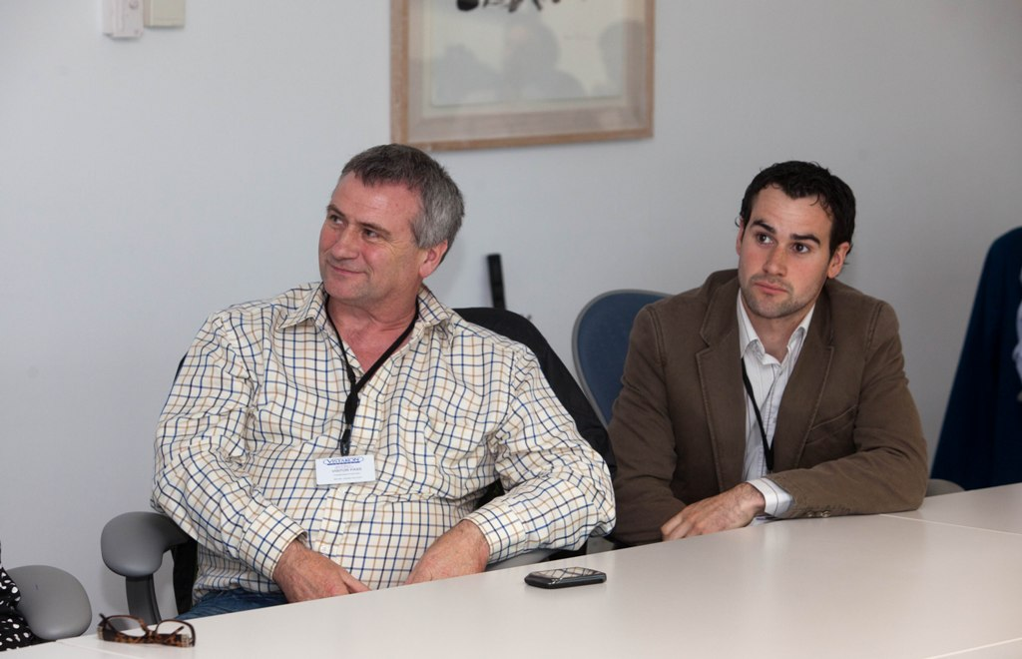
Gerard Duffy and Daryl Duffy – Eurotech Renewables, Winners of the Brecan Mooney Installation of the Year Competition 2011.

Slide 12
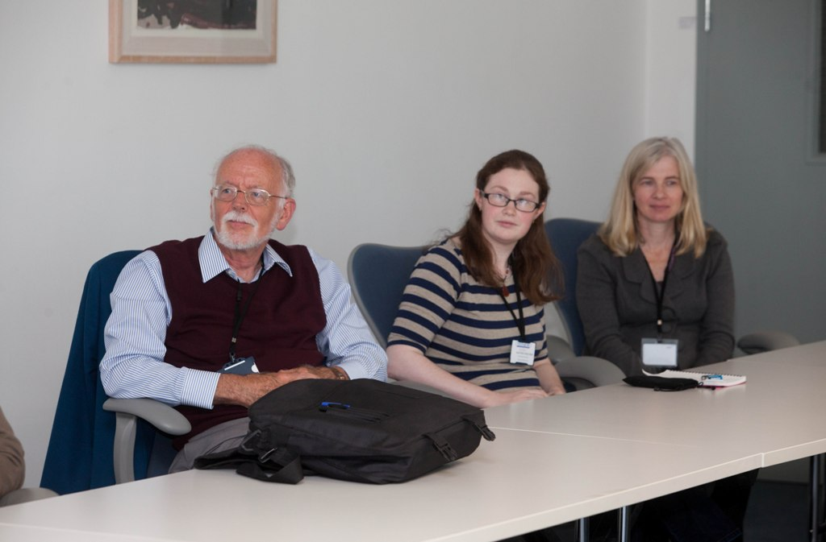
Gareth Jones Newsletter Editor, Laurena Lacey GAI member, Roisin Goodman Vice-chair GAI

Slide 13
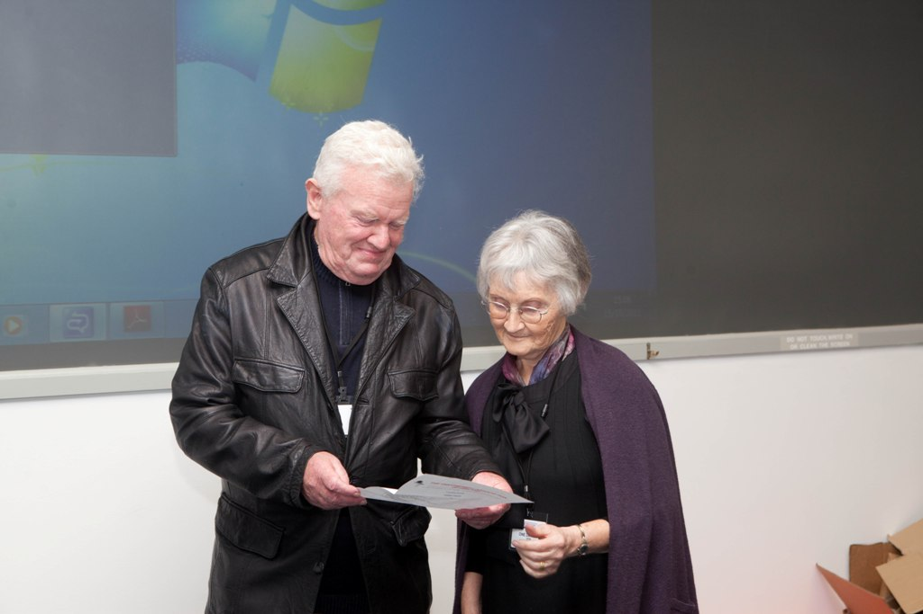
Brian Mooney and Noreen Mooney, parents of Brecan Mooney, announce the Winner of the Geothermal Installation of the Year Award 2011

Slide 14
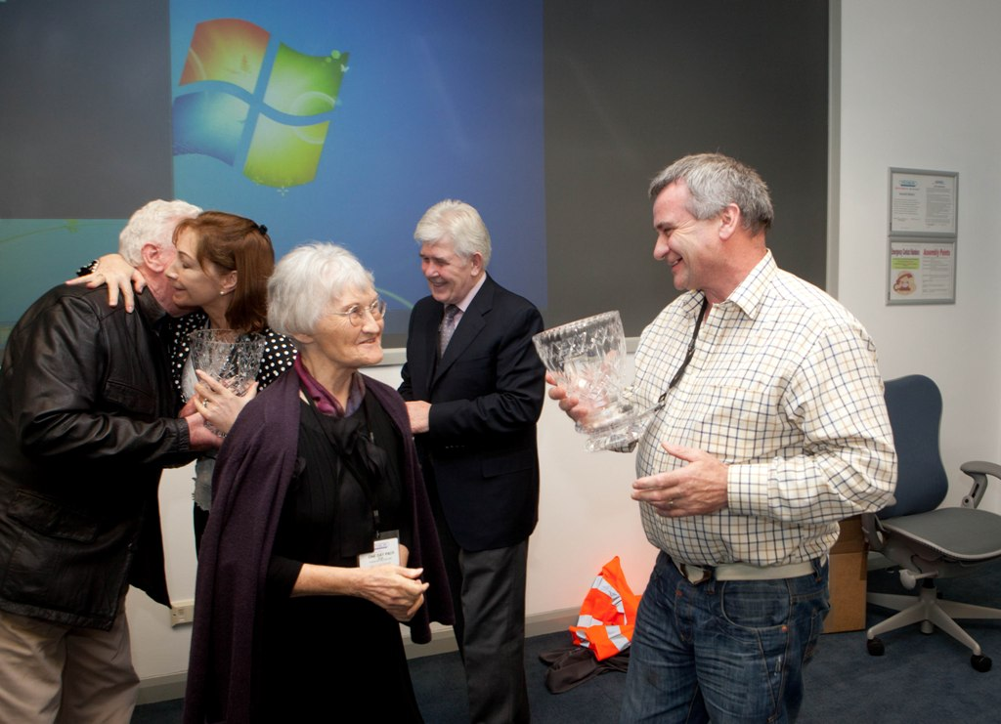
Brian Mooney and Noreen Mooney, parents of Brecan Mooney present Gerard Duffy (Eurotech Renewables) and Sean and Mary Mc Donald (homeowners), with the Geothermal Installation of the Year Award 2011

Slide 15
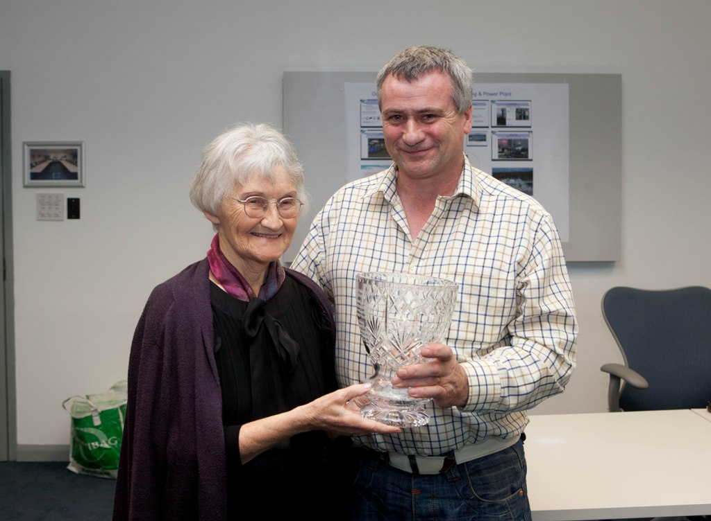
Noreen Mooney and Gerard Duffy of Eurotech Renewables Eurotech Renewables Limited was awarded the inaugural Brecan Mooney domestic geothermal heating installation of the year award 2011, for the innovative geothermal heating system it installed in Sean and Mary McDonald’s home in Co. Meath

Slide 16
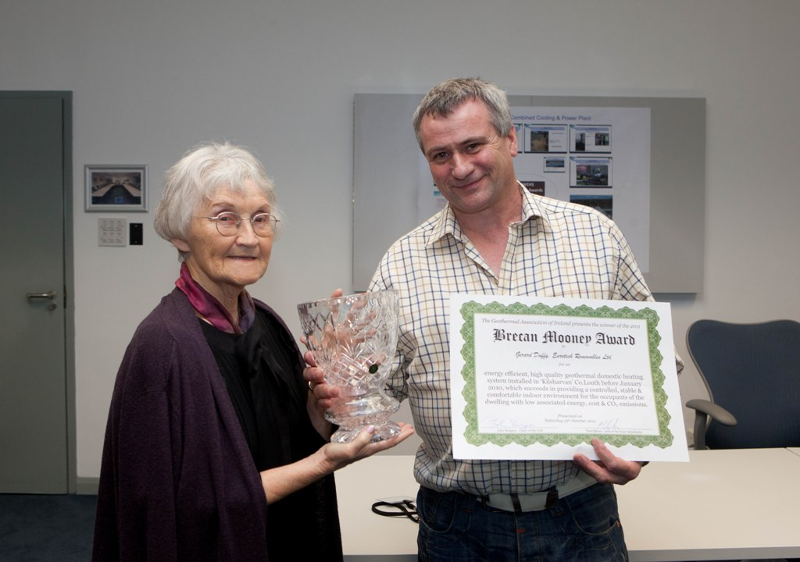
Noreen Mooney and Gerard Duffy of Eurotech Renewables Eurotech Renewables Limited was awarded the inaugural Brecan Mooney domestic geothermal heating installation of the year award 2011, for the innovative geothermal heating system it installed in Sean and Mary McDonald’s home in Co. Meath

Slide 17
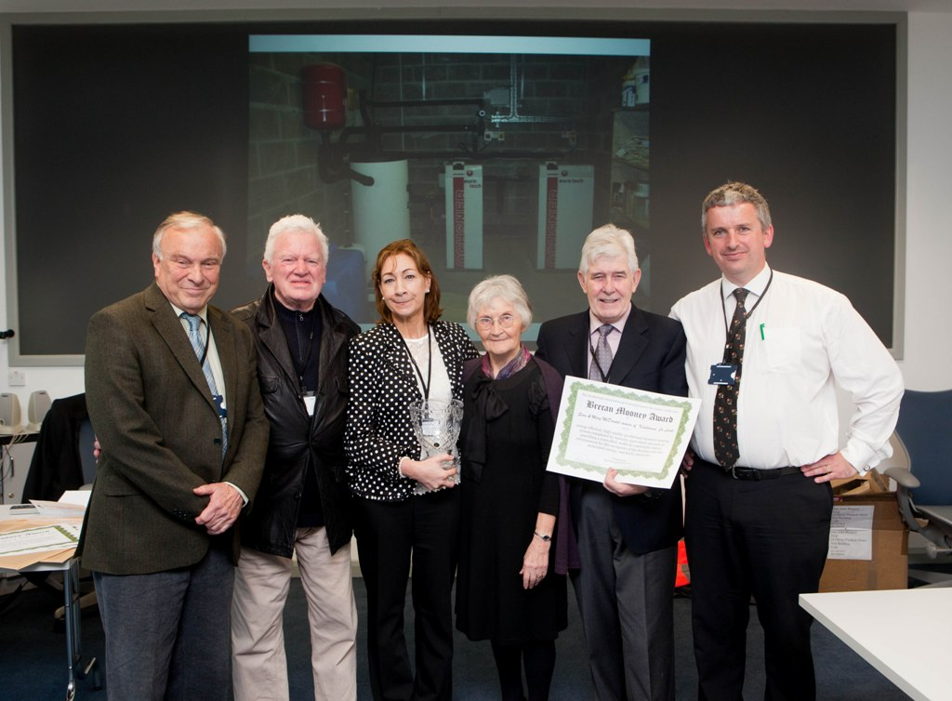
Paul Sikora, (GAI Development Officer), Brian Mooney, Mary Mc Donald (homeowner), Noreen Mooney, Sean Mc Donald (homeowner) John Burgess (Chairman of the GAI ).

Slide 18
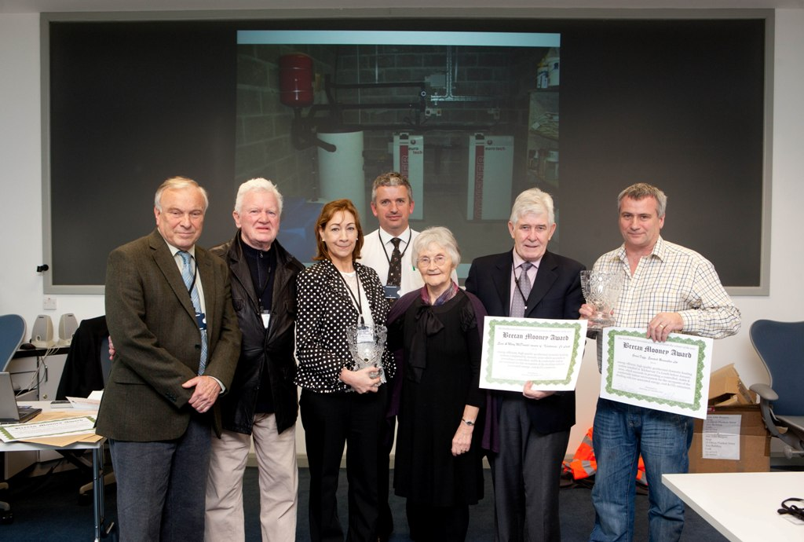
Paul Sikora, (GAI Development Officer), Brian Mooney, Mary Mc Donald (homeowner), John Burgess (Chairman of the GAI), Noreen Mooney, Sean Mc Donald (homeowner), Gerard Duffy of Eurotech Renewables (Winner of the Brecan Mooney Installation of the Year Award 2011)

Slide 19
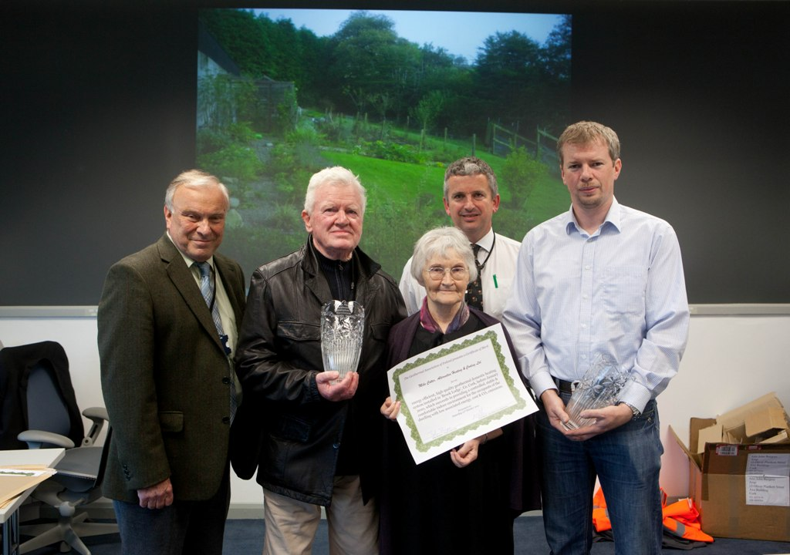
Paul Sikora, (GAI Development Officer), Brian Mooney, John Burgess (Chairman of the GAI), Noreen Mooney, Mike Cotter of Alternative Heating & Cooling Ltd who was awarded a Brecan Mooney Award of Merit for the geothermal system Alternative Heating & Cooling Ltd installed for Nick & Anne Ross of ‘Brook Lodge’ Co. Cork

Slide 20
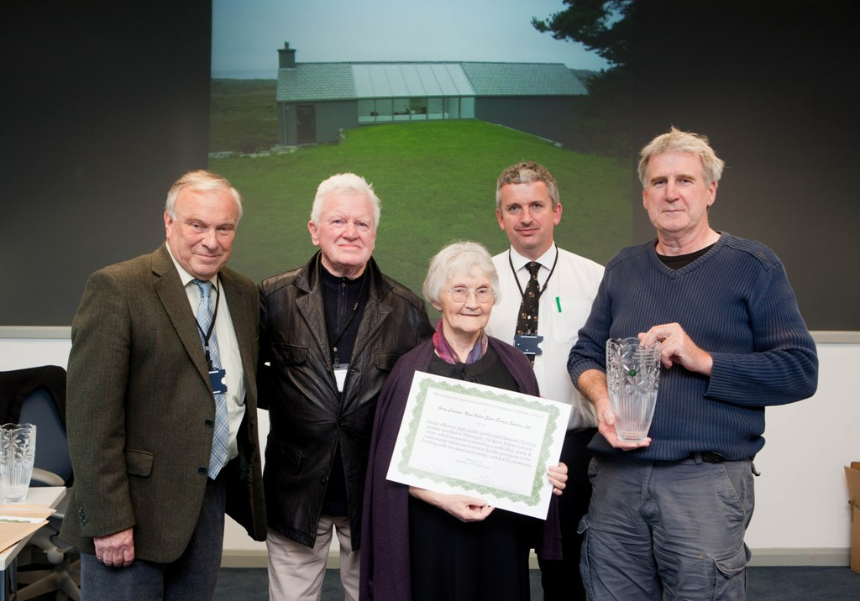
Paul Sikora, (GAI Development Officer), Brian Mooney, John Burgess (Chairman of the GAI), Noreen Mooney, Gerry Cunnane of Wind Water Solar Energy Systems Ltd. who was awarded a Brecan Mooney Award of Merit for the geothermal system Wind Water Solar Energy Systems Ltd. installed for Jochen Gerz and Laurence Vanpoulle of ‘DerryQuin’, Co. Kerry.

Slide 21
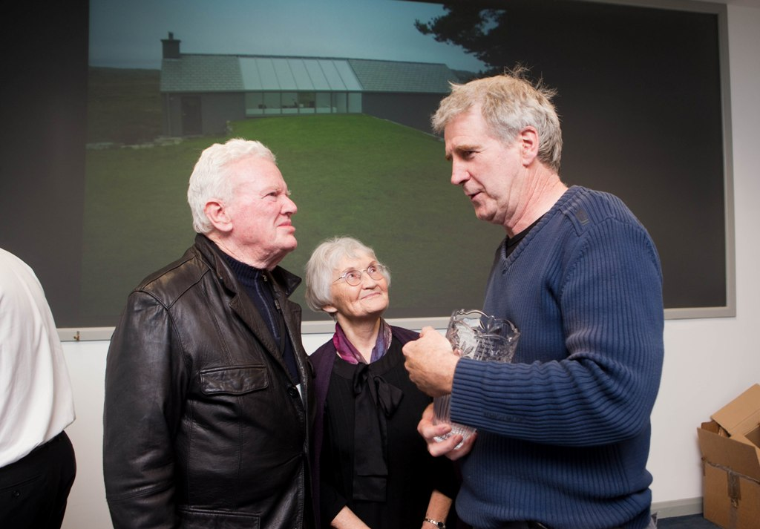
Brian Mooney, Noreen Mooney, and Gerry Cunnane of Wind Water Solar Energy Systems Ltd. who was awarded a Brecan Mooney Award of Merit for the geothermal system Wind Water Solar Energy Systems Ltd. installed for Jochen Gerz and Laurence Vanpoulle of ‘DerryQuin’, Co. Kerry.

Slide 22
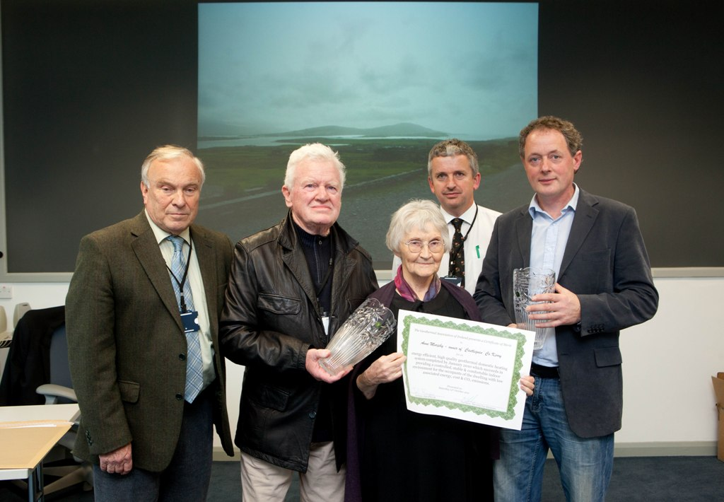
Paul Sikora, (GAI Development Officer), Brian Mooney, John Burgess (Chairman of the GAI), Noreen Mooney, Padraig Murphy of Green Renewable Heating Ltd. who was awarded a Brecan Mooney Award of Merit for the geothermal system Green Renewable Heating Ltd installed for Anne Murphy of ‘Castlequin’, Co Kerry.

Slide 23
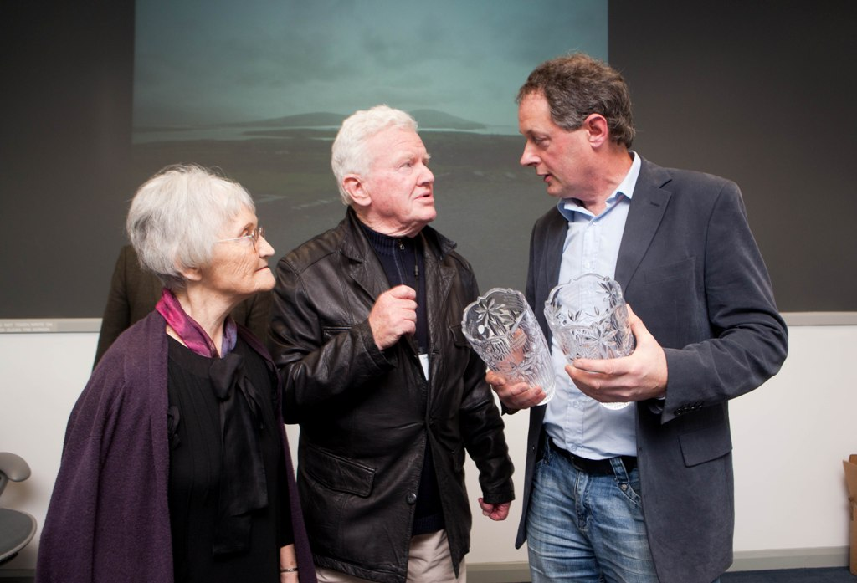
Brian Mooney, Noreen Mooney, and Padraig Murphy of Green Renewable Heating Ltd who was awarded a Brecan Mooney Award of Merit for the geothermal system Green Renewable Heating Ltd installed for Anne Murphy of ‘Castlequin’, Co Kerry.

Slide 24
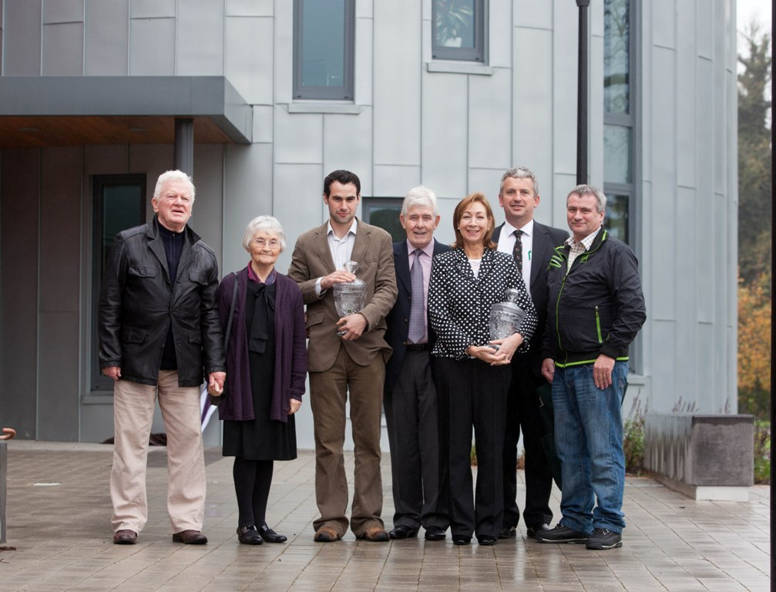
Brian and Noreen Mooney, Daryl Duffy of Eurotech Renewables (Winners of the Brecan Mooney Installation of the Year Award 2011), Sean and Mary Mc Donald (homeowners) John Burgess (Chairman of the GAI), Gerard Duffy (Eurotech Renewables)

Slide 25
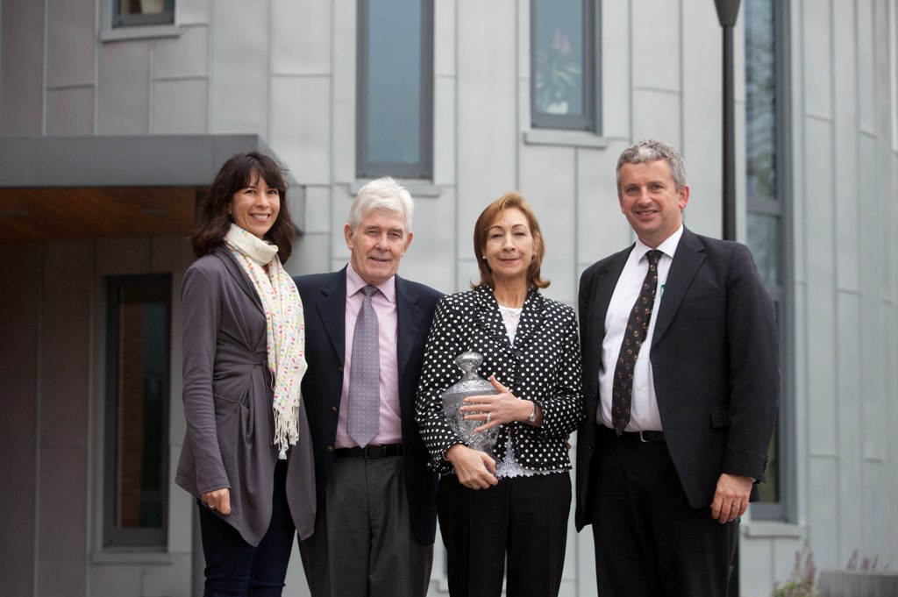
Monica Lee (GAI Secretary) Sean and Mary Mc Donald (winning homeowners) and John Burgess (Chairman of the GAI )

Slide 26
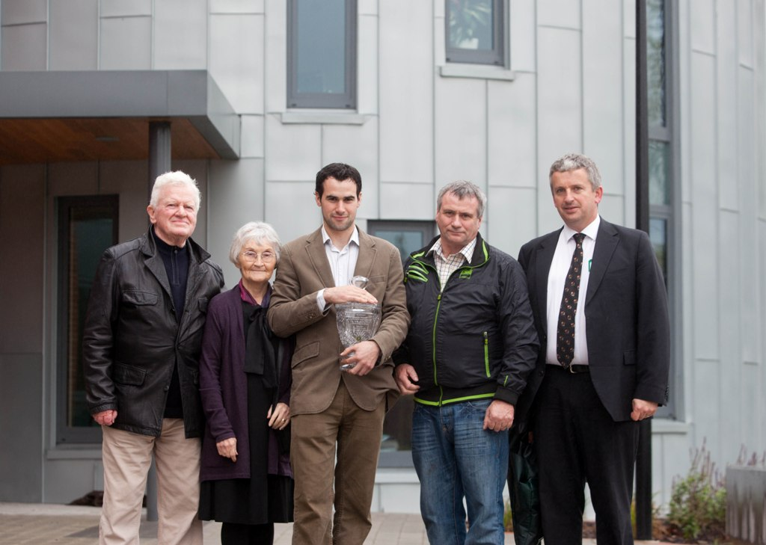
Brian and Noreen Mooney (parents of Brecan Mooney), Daryl Duffy and Gerard Duffy (Eurotech Renewables, Winners of the Brecan Mooney Installation of the Year Competition 2011) and John Burgess (Chairman of the GAI)

Slide 27
Sean and Mary Mc Donald (winning homeowners) and John Burgess (Chairman of the GAI)

Slide 28
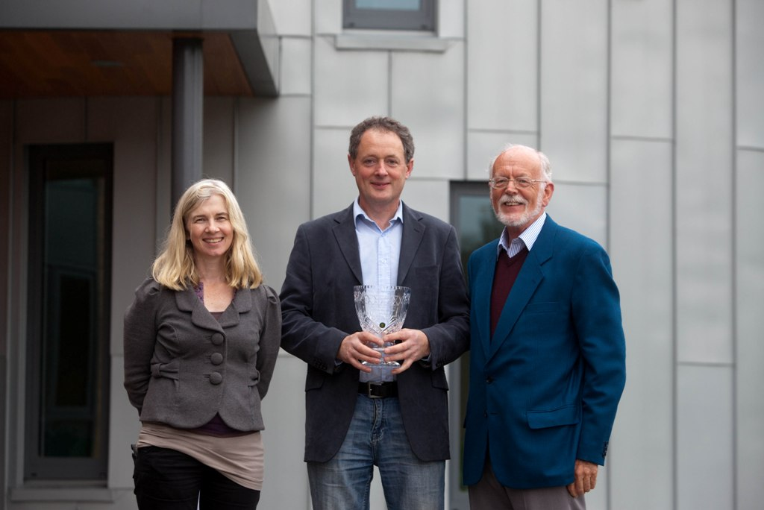
Roisin Goodman (Geothermal Association of Ireland), Padraig Murphy of Green Renewable Heating Ltd. who was awarded a Brecan Mooney Award of Merit for the geothermal system Green Renewable Heating Ltd installed for Anne Murphy of ‘Castlequin’, Co Kerry and Gareth Jones (Geothermal Association of Ireland)

Slide 29
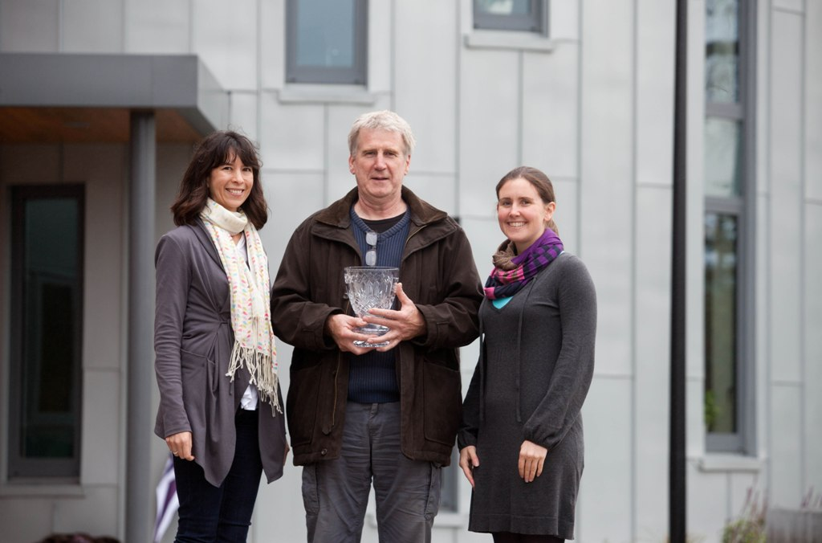
Monica Lee (Secretary GAI), Gerry Cunnane of Wind Water Solar Energy Systems Ltd. who was awarded a Brecan Mooney Award of Merit for the geothermal system Wind Water Solar Energy Systems Ltd. installed for Jochen Gerz and Laurence Vanpoulle of ‘DerryQuin’, Co. Kerry, Heather Murphy (Membership Officer, GAI)

Slide 30
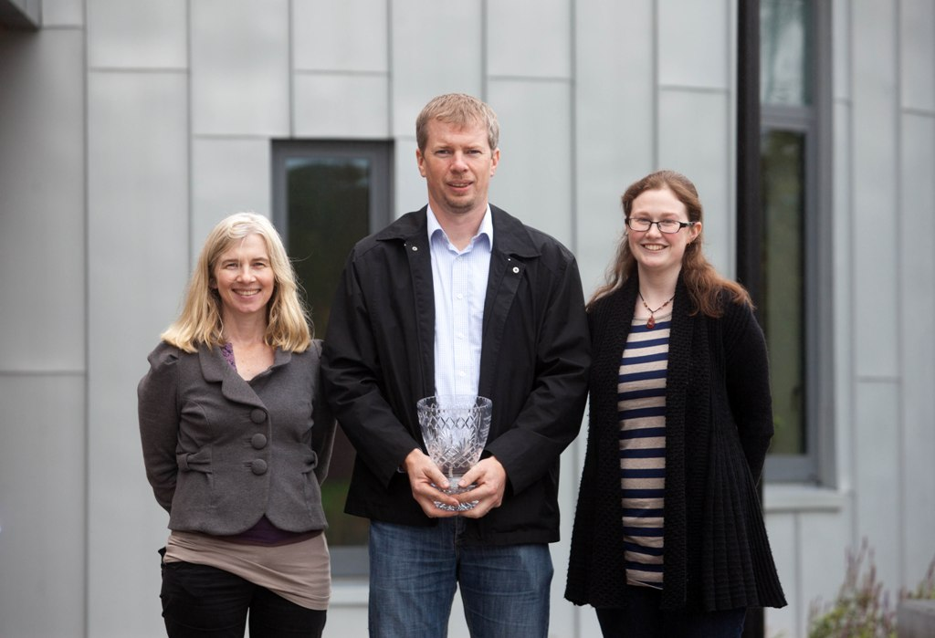
Roisin Goodman (Vice-Chair GAI), Mike Cotter of Alternative Heating & Cooling Ltd who was awarded a Brecan Mooney Award of Merit for the geothermal system Alternative Heating & Cooling Ltd installed for Nick & Anne Ross of ‘Brook Lodge’ Co and Laurena Lacey (Member GAI)

Slide 31
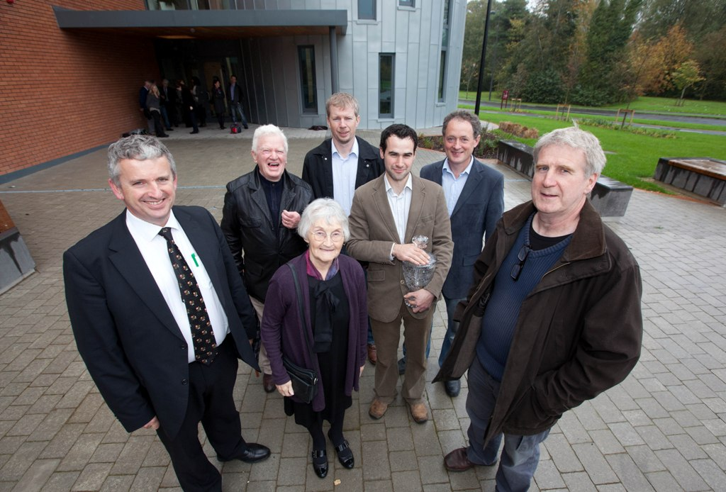
Back Row John Burgess (Chair of the GAI), Brian Mooney, Mike Cotter of Alternative Heating & Cooling Ltd who received an Award of Merit for the geothermal system installed for Nick & Anne Ross of ‘Brook Lodge’ Co.Cork, Padraig Murphy of Green Renewable Heating Ltd. who received an Award of Merit for the geothermal system installed for Anne Murphy of ‘Castlequin’, Co Kerry. Front Row Noreen Mooney, Daryl Duffy of Eurotech Renewables, Winner of the Brecan Mooney Installation of the Year Competition 2011 for the geothermal system installed in Sean and Mary McDonald’s home in Co. Meath and Gerry Cunnane of Wind Water Solar Energy Systems Ltd. who received an Award of Merit for the geothermal system installed for Jochen Gerz and Laurence Vanpoulle of ‘DerryQuin’, Co. Kerry

Slide 32
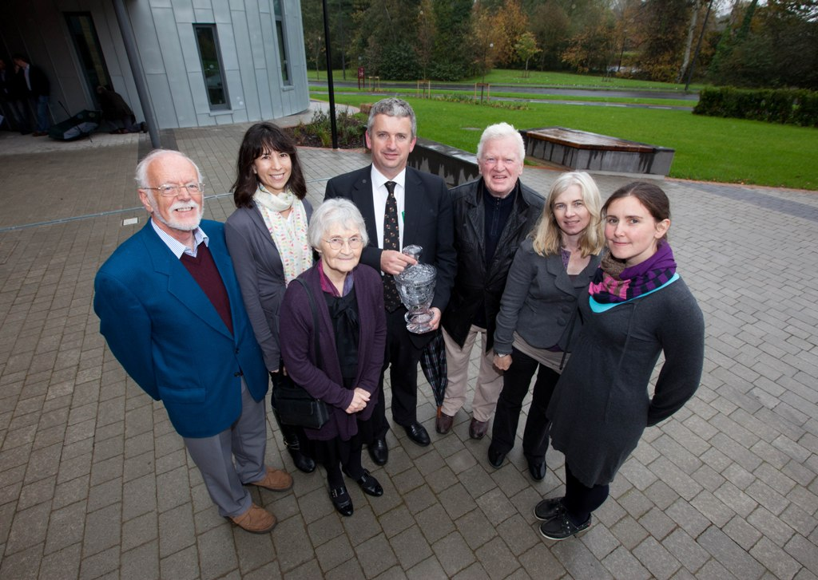
Gareth Jones, (GAI Newsletter Editor), Monica Lee (GAI Secretary), Noreen Mooney, John Burgess (Chairman of the GAI), Brian Mooney, Roisin Goodman(GAI Vice-Chair) and Heather Murphy( GAI Membership Officer)

Slide 33
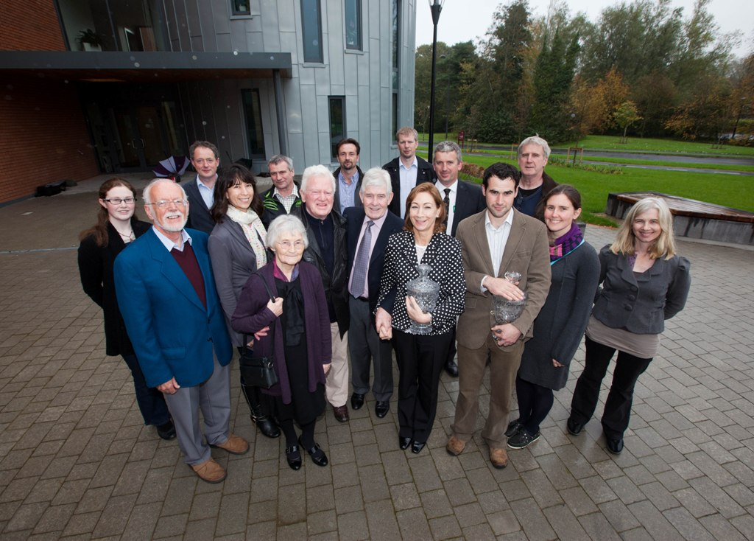
Brian Mooney and Noreen Mooney, parents of Brecan Mooney presented the Brecan Mooney Installation of the Year Award to Daryl Duffy of Eurotech Renewables Limited for the innovative geothermal heating system it installed in Sean and Mary McDonald’s home in county. Pictured along with Gerry Cunnane of Wind Water Solar Energy Systems Ltd. Padraig Murphy of Green Renewable Heating Ltd. and Mike Cotter of Alternative Heating & Cooling Ltd who were all awarded a Brecan Mooney Award of Merit at the Award Ceremony together with Members of the GAI Committee

Slide 34
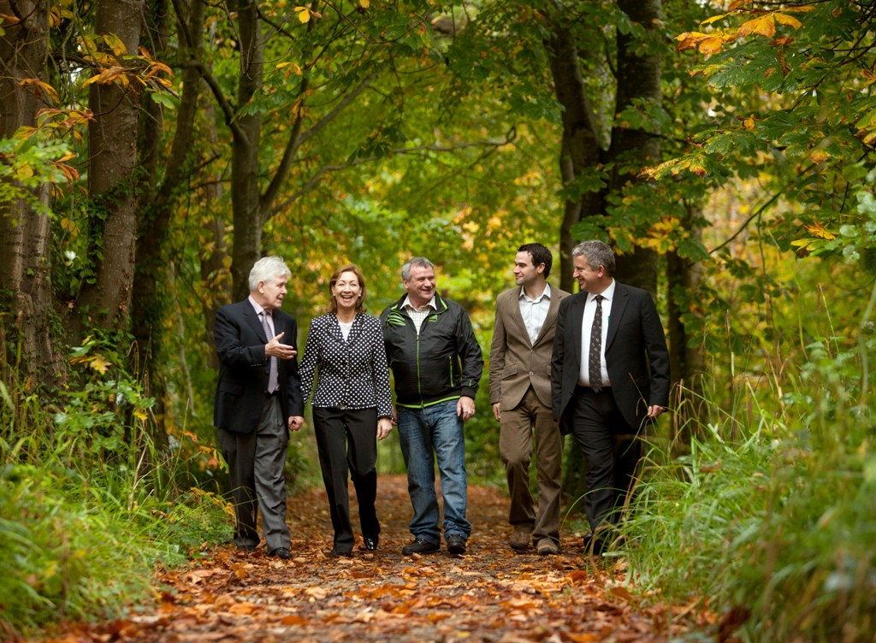
Going Green— Eurotech Scoops Geothermal Award
Eurotech Renewables Limited was awarded the inaugural Brecan Mooney domestic geothermal heating installation of the year award 2011 by the Geothermal Association of Ireland, for the high performance geothermal heating system it installed in Sean and Mary McDonald’s home in county Meath, at a prize giving ceremony in Limerick on Saturday 15 October 2011
Pictured (L to R) Sean and Mary McDonald (homeowners) Gerard Duffy and Daryl Duffy (Eurotech Renewables Limited), and John Burgess (Chairman of the GAI)

